Slide 1
Preventing Prescription Opioid and Fentanyl Overdose
Texas Targeted Opioid Response
PRESENTERS NAME

Slide 2
Presenting Organization
PRESENTED BY
Texas Targeted Opioid Response

Slide 3
Agenda
Texas Facts and Figures
What are opioids?
What are the risks of prescription opioids?
What is fentanyl?
Common Misconceptions
Actions You Can Take

Slide 4
“One in four Texans has experienced an opioid overdose or knows someone who has.”
Based on results from panel surveys conducted in 2020 and 2021 with a total of 3,347 adult participants throughout Texas. Participants were selected to reflect current Texas demographics, including age, gender and ethnicity.

Slide 5
Texas Facts and Figures
01

Slide 6
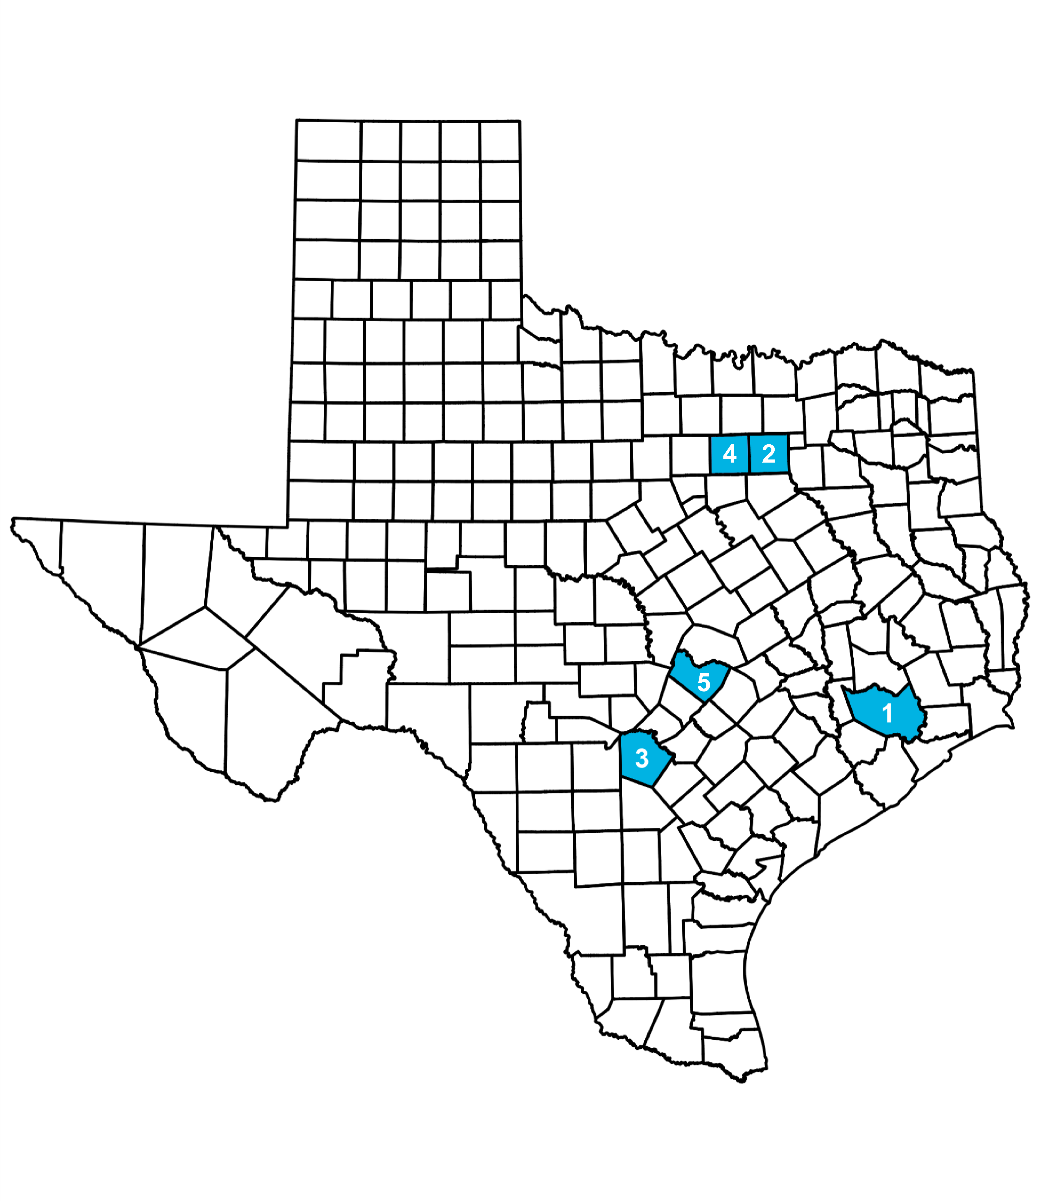
One in four Texans has experienced an opioid overdose (also referred to as a poisoning) or knows someone who has.
Top five counties in Texas with the highest counts of opioid overdose deaths as of 2022:
Harris County
Dallas County
Bexar County
Tarrant County
Travis County
Nearly one in six Texas students in grades 7-12 has taken prescription drugs without a doctor’s prescription, according to the Texas Health and Human Services Commission.
In 2020, nearly 3,721 Texans died from drug overdoses, making it one of the leading causes of injury-related deaths in Texas, according to the Texas Department of State Health Services (DSHS). Of those deaths, more than 50% involved a prescription or illicit opioid. Fentanyl is the leading cause of all opioid overdose deaths, according to DSHS.

Slide 7
Five Texans die every day, on average, from an accidental fentanyl overdose.
Opioid Overdose Epidemic in the U.S.: Three Waves of Opioid Overdose Deaths
Wave 1: Rise in prescription opioid overdose deaths started in the 1990s.
Wave 2: Rise in heroin overdose deaths started in 2010.
Wave 3: Rise in synthetic opioid (including fentanyl) overdose deaths started in 2013.

Slide 8
Regional Data
REGION NAME
Titles and subtitles can be changed.
You can present regional data specific to your organization’s area here.
See Texas Department of State Health Services health data: https://healthdata.dshs.texas.gov/dashboards/drugs-and-alcohol/opioids/

Slide 9
What are opioids?
02

Slide 10
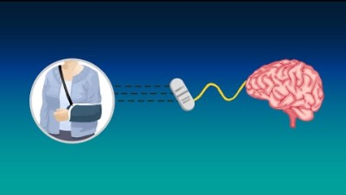
See How Prescription Opioids Work
Notes:
Video Link: https://www.youtube.com/watch?v=2w0zT1oCPVI

Slide 11
Prescription opioids are a class of powerful pain management medications.
Prescribed to help with pain from:
A serious injury
Surgery
C-section birth
Cancer and more
Some examples of brand names include:
Lortab
Ultram
Tylenol with Codeine
Percocet
Vicodin
OxyContin

Slide 12
What are the risks of prescription opioids?
03

Slide 13
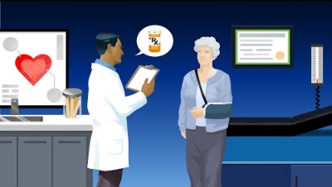
Learn the Risks of Opioid Misuse
Notes:
Video Link: https://www.youtube.com/watch?v=is9I_BsjO_U

Slide 14
Your body can become dependent on prescription opioids after just seven days, potentially setting you on a path toward addiction.
Your body and brain quickly get used to the medication. As a result:
The prescribed amount becomes less and less effective.
You would need more to manage the pain, which increases the risk of misuse and overdose.
Look for signs of withdrawal after physical dependence, such as:
Insomnia
Anxiety
Nausea
Muscle aches
Restlessness

Slide 15
Opioids are powerful medications for people with severe pain, but misusing them can be dangerous or even deadly.
Misuse is taking opioids any way other than what is prescribed by a doctor. Examples of misuse include:
Taking more than prescribed
Taking them without a prescription
Any non-medical use
Taking more than necessary can lead to dangerous side effects, including:
Oversedation
Slowed breathing
Overdose
Death

Slide 16
What is fentanyl?
04

Slide 17
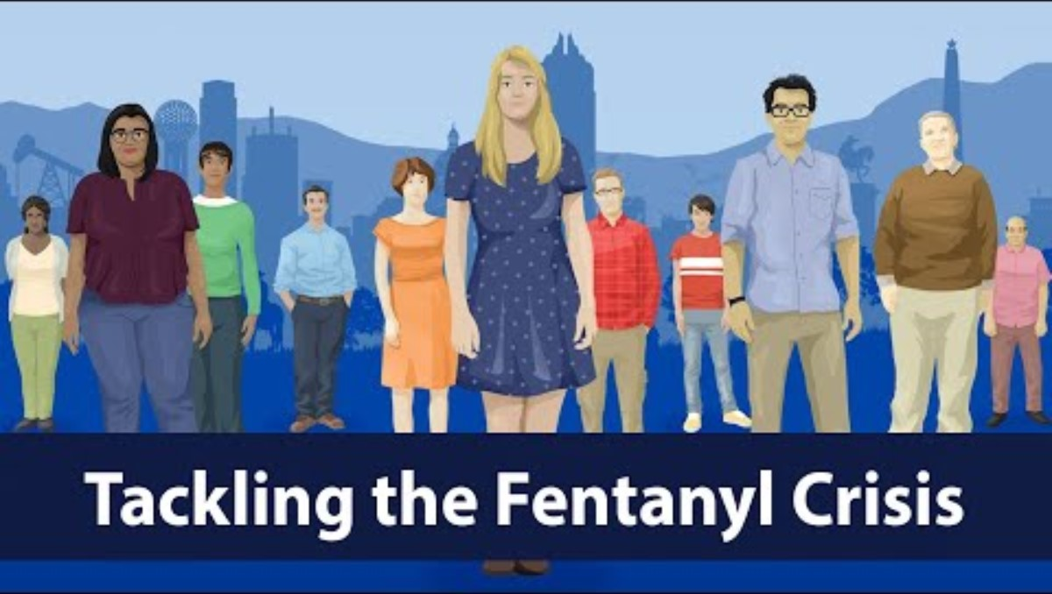
Together, Texans Are Tackling the Fentanyl Crisis
Notes:
Video Link: https://youtu.be/AR7NuBetJJg?si=6NRWm7IxfUQiZpYY

Slide 18
Fentanyl, a powerful opioid, is taking the lives of Texans every day.
Fentanyl is an opioid 50 times stronger than heroin. It is safe when taken as prescribed by a doctor to treat severe pain. However, illegally manufactured fentanyl is often mixed into counterfeit pills. Even in small doses, fentanyl can cause a life-threatening overdose. It may be added to substances with or without a person’s knowledge.
Counterfeit (fake) pills can be made to look like pills that come from a pharmacy, such as:
Oxycodone
Vicodin
Percocet
Xanax
Adderall
Fentanyl can also be added to other illegal substances, such as:
Heroin
Cocaine
Methamphetamine MDMA (also known as “ecstasy” or “Molly”)
To reduce your risk, talk about the dangers of accidental fentanyl overdose with loved ones and only take pills prescribed to you. Carry naloxone to save a life in the event of an overdose.

Slide 19
Learn the signs of an overdose.
Overdose can happen when a person:
Intentionally or unintentionally takes too much of an opioid.
Mixes opioids with other drugs or alcohol at a level that is toxic to the body.
Knowingly or unknowingly takes a counterfeit prescription pill that has been poisoned with fentanyl.
Signs of an overdose:
Small, constricted “pinpoint pupils.”
Face is extremely pale or feels clammy to the touch.
Body goes limp.
Fingernails or lips have a purple or blue color.
Vomiting or making gurgling noises.
Cannot be awakened or unable to speak.
Breathing or heartbeat slows or stops.
For people with lighter skin, the skin may turn blue or purple. For people with darker skin, the skin may turn gray or ashen.

Slide 20
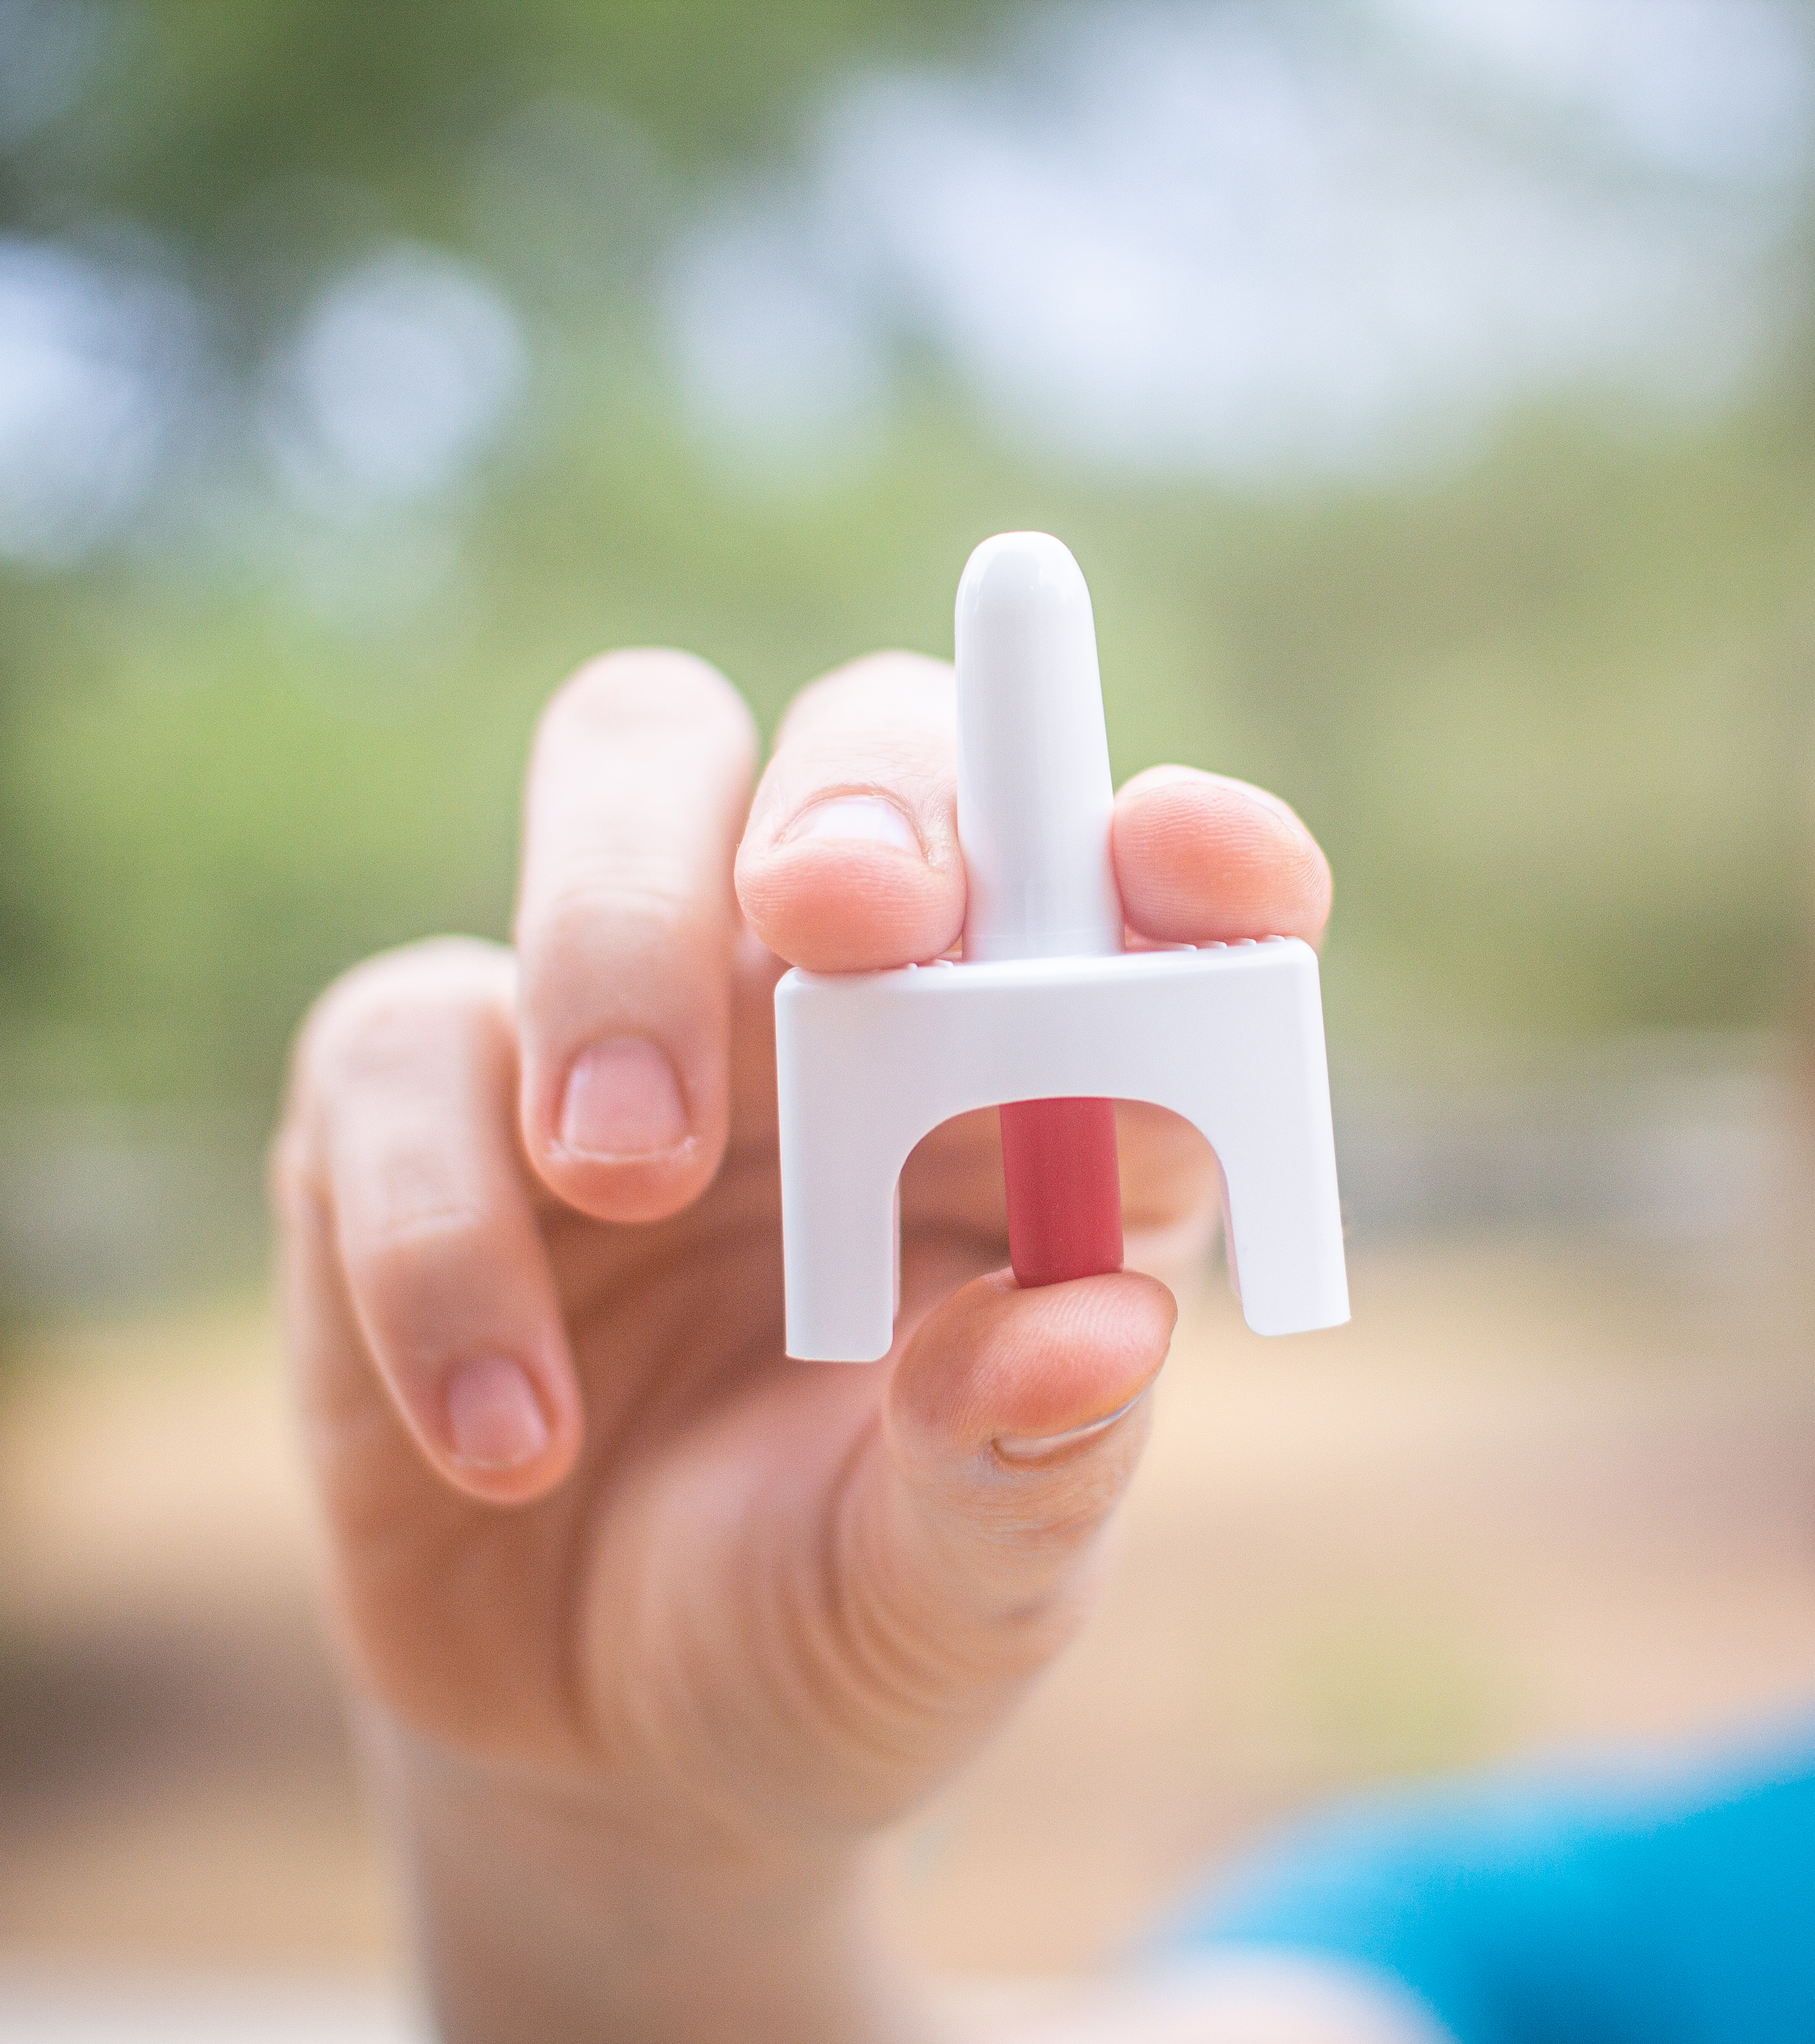
How to respond to an overdose:
Call 911 right away.
Try to wake the person up.
Tilt the person’s head back and give naloxone, if available.
Begin rescue breathing or CPR.
Turn the person on their side to prevent choking.
Stay with the person until emergency services arrive.

Slide 21
Common Misconceptions
04

Slide 22

Fact vs. Myth
Any use of prescription opioids is unsafe.
Myth
When taken as directed, prescription opioids are one way to manage severe short-term and chronic pain.
Fact

Slide 23

Fact vs. Myth
The language and words that we use when talking about substance use doesn’t matter much one way or the other.
Myth
When talking about opioids our words do matter. Language that labels or blames people experiencing opioid use disorder can cause harm and make them feel ashamed, alone or helpless, and less likely to seek help.
Fact

Slide 24

Fact vs. Myth
Texas doesn’t notice the opioid crisis as an issue of concern and treatment is hard to find.
Myth
The opioid crisis is a big priority for Texas. There are a variety of state and national resources available to help get you started on a path to treatment and recovery.
Fact

Slide 25
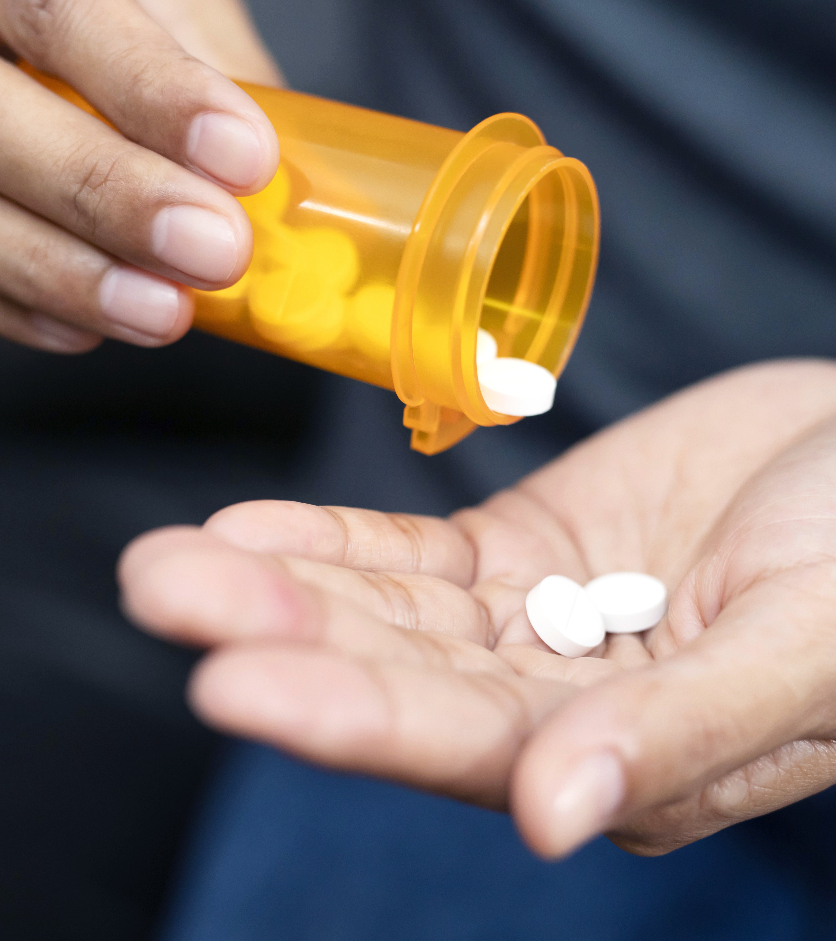
Fact vs. Myth
You can tell if fentanyl is in your drug by looking at it.
Myth
Fentanyl is nearly impossible to detect on your own because you can’t see, taste or smell it. Even one pill can cause a fatal overdose.
Fact

Slide 26
Words to Avoid
Drug user, abuser, doing drugs
Doctor shopping
Addict, pill popper, junkie
Clean, dirty

Slide 27

Words to Use
A person who misuses medication
Medication-seeking behavior
A person with opioid use disorder
Negative, positive, substance-free

Slide 28
Actions You Can Take
05

Slide 29
How You Can Help
If you are prescribed opioids by a doctor:
Only take your medication exactly as prescribed.
Never increase, cut back or stop taking your medication before talking to your doctor.
Keep your medications in a place where children and other family members cannot access them.
Only take pills prescribed to you. If it didn't come from your doctor or pharmacist, you can't be sure that it's safe.

Slide 30
How You Can Help
Having naloxone on hand to reverse bad reactions or accidental ingestion can save someone’s life.
Naloxone blocks the effects of opioids and rapidly reverses overdose.
It works by helping someone who is unresponsive to breathe normally again.
Naloxone has no effect if opioids are not present in a person’s system.
How to get naloxone:
Over-the-counter naloxone is available for purchase without a prescription in places like pharmacies, convenience stores, grocery stores, gas stations and online. It’s also available at no cost from NaloxoneTexas.com.

Slide 31
How You Can Help
For anyone struggling with opioid addiction, help is available:
2-1-1 Texas: Connection to services and resources in your community
Call 2-1-1
SAMHSA 24/7 National Helpline: Treatment referrals for people and families facing substance use disorders or mental health issues
Call 800-662-4357 (800-662-HELP)
9-8-8 Suicide & Crisis Lifeline: If you are considering suicide, call, text or chat this number to talk to a crisis counselor for confidential emotional support 24/7
9-8-8
988LifeLine.org/Chat
Explore other resources to get started on a path to treatment and recovery at TxOpioidResponse.org/Resources

Slide 32

How You Can Help
If you plan to talk to a friend, child or loved one about their opioid use:
Be specific. Explain what you observed that made you concerned, without making accusations.
Ask open ended questions to create a two-way dialogue and listen as much as you talk.
Express how much you care about them and reassure them that you can be counted on for support.

Slide 33
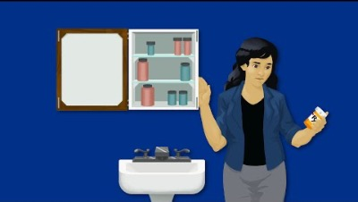
How to Talk About Prescription Opioid Misuse
Notes:
Video Link: https://www.youtube.com/watch?v=9U3MIFYGPek&t=1s

Slide 34
Treatment is available and recovery is possible.
No one sets out to be addicted to opioids. Addiction is a disease that can affect anyone. Everyone deserves help.
PRESENTER CREDENTIALS AND CONTACT INFO

